Slide 1
Creating a Control Mapping Program for Game Accessibility
Ruya Kumru-Holroyd
P2512547
CTEC3451 Development Project
Notes:
Hello, my name is Ruya Kumru-Holroyd and I am a third year Computer Games programming student and I am here today to deliver to you, my final year development project, Creating a Control Mapping Program for Game Accessibility.

Slide 2
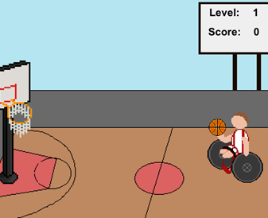
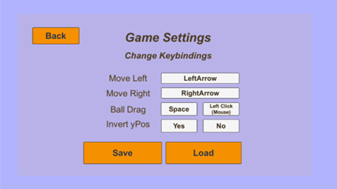
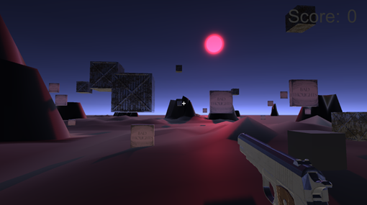
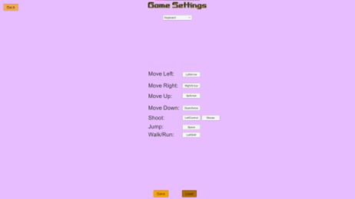
Agenda
Introduction
Research
System Design
Project Development
Demonstration
Summary
Notes:
The agenda for this presentation consists of an introduction, the research gone into this project, the system design, the development of the project itself, a short demonstration of the program and a summary to conclude with.

Slide 3



Introduction
There is a need for game accessibility and representation in the games we play.
46 million video game players have disabilities and use them to help escape from reality.
“the representation ratio in media is abysmally low, and worse, it’s almost condescending and tear-based content“
Control Mapping program so that players can play games more easily and accessible for them.
Two prototype games needed to test the mapping program.
Unity3D 2020.3.12f1 and C# language was used to create this project.
Notes:
There are millions of video games available worldwide, but how many are actually accessible and well represented? The answer is less than you might expect. There are around 46 million video game players who have disabilities, which is around 1 in 5 of all gamers in the United States.
However “the representation ratio in media is abysmally low, and worse, it’s almost condescending and tear-based content” were the words from Pascal Clarysse in their article about positive disability representation in gaming. Which is why there is a need to have awareness and for action.
Many of these players are unable to play popular games due to the complexity and lack of accessibility options for them, and do not hold any disability representation or if they do, can be negative and inaccurate.
Therefore, I wanted to create a Control Mapping program for game accessibility so that players can use their own controllers or key-bindings to play games more easily and accessible for them, and also to demonstrate that it is possible to do so and that this concept can be used and altered for future uses.
In the project itself, it is composed of three parts, there are two simple prototype games that, include disability representation of their own, and the control mapping program itself, the two games were created in order to test the mapping program between two games, but also to showcase the representation of disabilities and using that as the core.
Unity3D and C# language was used in the creation of this project.

Slide 4


Research
Notes:
The first topic of this presentation is the research that took place.
For this development project, a Literature Review was carried out to do research on the choice of topic, which in this case is about game accessibility, representation and mapping programs. In my research I came across many books and articles that gave me information on video games as a whole, from when they first began to where they are now, and on the different types of representations currently existing in video games, the types of accessibility options and their timeline and on different mapping programs that currently exist.

Slide 5
Representation
Good and Bad representation
Notion of fixing disabilities with prosthetics or superpowers
Overwatch characters and Joker from Mass Effect showcase positive representation
AbleGamers article discussed a wheelchair basketball video game
Mental Health not portrayed near enough compared to Physical Disabilities
Notes:
When searching for the representation of disabilities in video games, I found out the difference between good and bad representation, an example of bad representation is in mainstream video games if a “protagonist is physically disabled in some manner, it’s usually immediately fixed through the use of cybernetics, prosthetics, or even cybernetic prosthetics.” this shows disabled characters are most likely to get ‘fixed’ in video games which is a deliberate term to verify it is a game construct and not easy to come by in real life, and Ian Hamilton an accessibility expert agrees, that there is still a notion in video games that people with disabilities are broken and need to be fixed, with tropes of these fixes being superpowers or superhuman prosthetics, also furthering the myth that a disability is rare.
However, positive representation, although few, can be found in games such as Overwatch, with the characters Symmetra and Ana who between them have Autism and the loss of an eye which is not replaced with any cybernetic prosthetics. There is Joker from the Mass Effect series who was born with Vrolik syndrome which causes extreme bone brittleness and so uses crutches and leg braces to move around, this has been seen as great representation because his disability does not define him, he is still fiercely independent despite the challenges he faces.
AbleGamers, a charity that helps disabled gamers, has an article called The Need for more disabilities in the games we play, where they discuss how there is little physical disability representation in games in our current society, and a good way to overcome this would be to have such a game such as Wheelchair Basketball, which could be like any other sports game out there, or another approach was to include disabled people in a wheelchair for a basketball video game, which was the approach that was taken as inspiration for one of the prototype games, that would be used for testing the mapping program.
When researching representation of mental health in video games, it was found that it was not portrayed near enough in video games compared to physical disabilities, therefore I wanted to make sure to have the other prototype game to include mental health as the disability to represent.

Slide 6
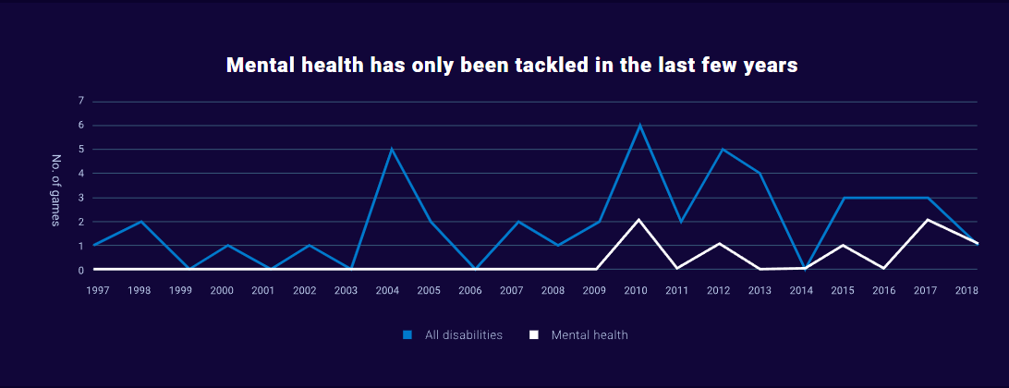
Disabilities Portrayed in Games
Notes:
The image is a diagram that shows the distribution of different types of disabilities portrayed in video games most often

Slide 7
Accessibility
Accessibility is the level that a product is available according to the number of people.
Accessibility in gaming has grown over the years.
Adaptive tech started in 1986 with Nintendo’s hands free controller.
Recently, the Microsoft Adaptive Controller (XAC) in 2018.
Notes:
Accessibility is the level that a product is available according to the number of people. It can also be thought of as a systems “ability to access” and benefit from it. Linking it to people with special needs and their rights to such organisations.
Over the years, accessibility in gaming has grown in accordance with the new technological advances being made. AbleGamers created a timeline that showcases adaptive tech and how far it has come, starting in 1986 where Nintendo created the first accessible technology with the hands free controller for the NES, PlayStation then added button mapping to their OS system in September 2009, AbleGamers themselves created the Adroit controller with Evil Controllers which introduced switch inputs for the first time, colourblind mode was added to the Borderlands 2 game in 2014 and finally in 2018 the Microsoft Adaptive Controller was released.

Slide 8
Accessibility
Silvio Carrera, “there was an increased amount of attention and control input necessary in order to play”
The lack of ability to reconfigure buttons and key bindings makes it more difficult to tailer a game to someone's demands
Playing video games can help you be more creative, increase your problem-solving abilities, and foster teamwork.
Notes:
Silvio Carrera, with their book Accessibility in Games: Including people with disabilities, explained that there was an increased amount of attention and control input necessary in order to play, due to the ever-growing size of video games and their complications as technology has advanced. They also mentioned that the lack of flexibility in the control options, such as the ability to reconfigure buttons, making it more difficult for someone with special needs to tailor the game to their demands,
Playing video games can help you be more creative, increase your problem-solving abilities and foster teamwork. People with disabilities, such as those with movement impairments may not be able to utilise a normal game controller and therefore have fewer options for enjoying video games.

Slide 9
Mapping Programs
Rewired
reWASD
Input Mapper
Xbox and PlayStation
Notes:
There are currently examples of mapping programs out there, for example there is rewired is a comprehensive input system for Unity that contains a configurable and saveable controller map as well as a control mapper system that uses the Unity GUI to allow players to rebind controllers in real time. Another example is reWASD which can remap controller buttons on PC which can be used on different games just by loading and setting the mappings on the program, including saving profiles for different games. A similar example is Input Mapper which auto detects the device for the user and allows them to choose the advanced macro and customisation settings, allowing them to adjust not only the device type, but also how inputs are translated and applied.
Other examples come from gaming consoles such as Xbox and PlayStation that include their own controller configurations and mappings

Slide 10
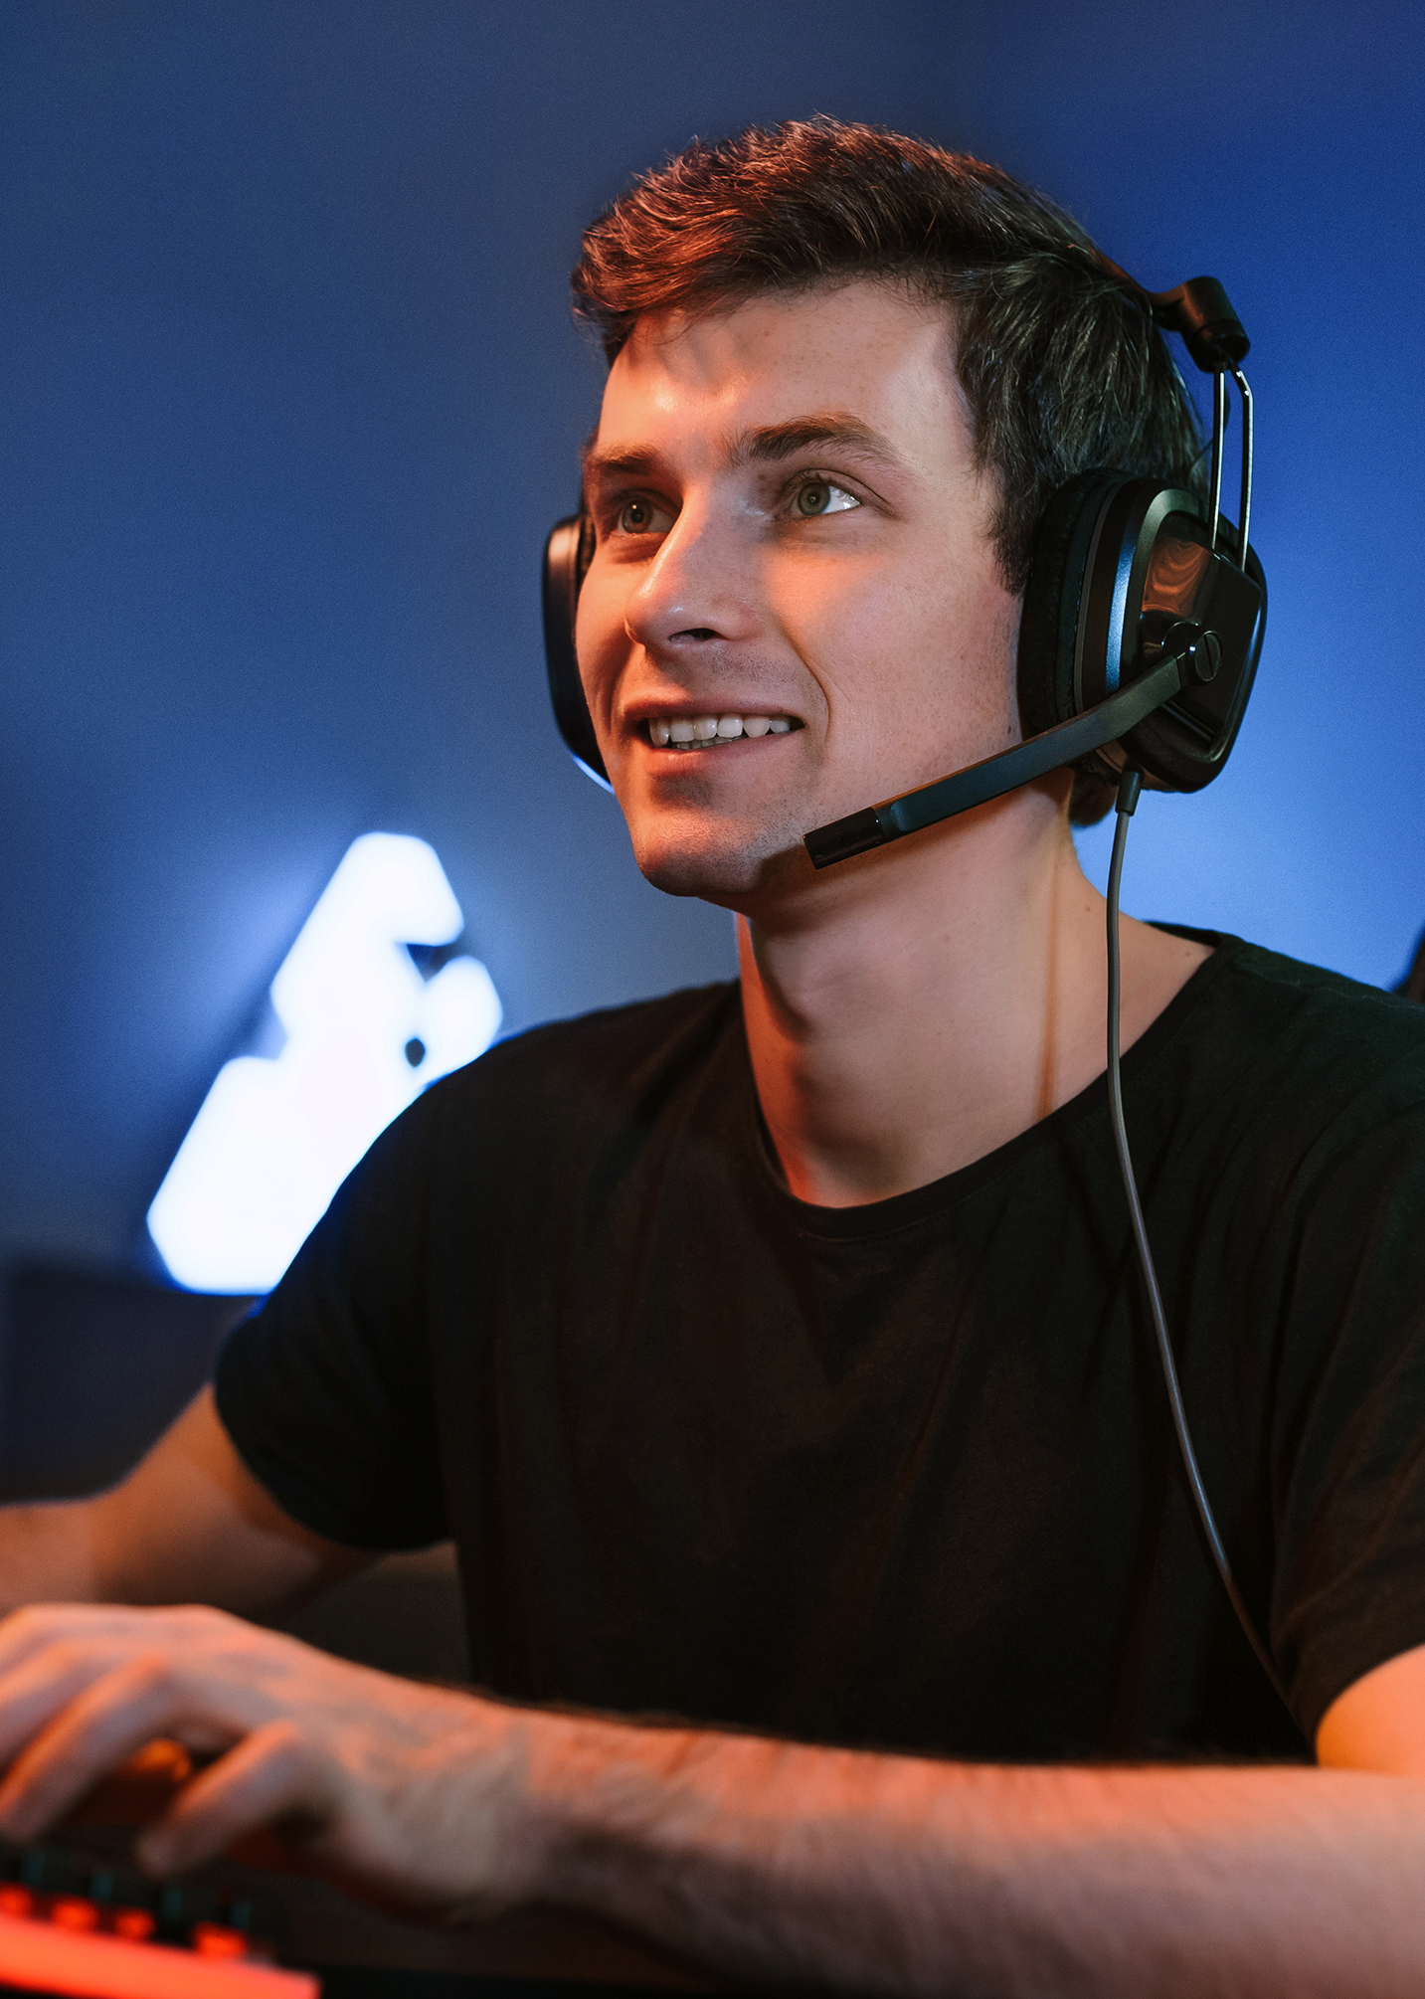
System Design
Notes:
The next topic I shall be discussing is the System Design of the project, this comes in three parts with the two prototype games and the control mapping program.

Slide 11
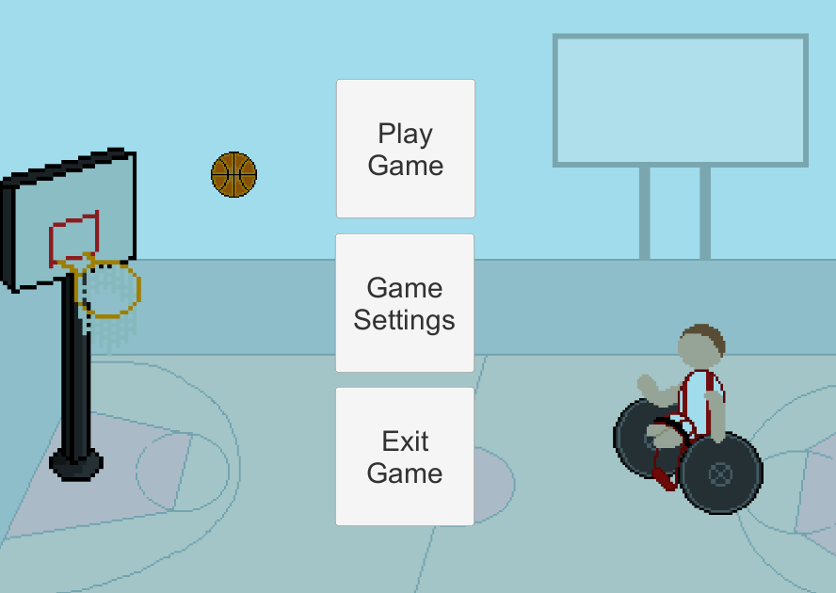
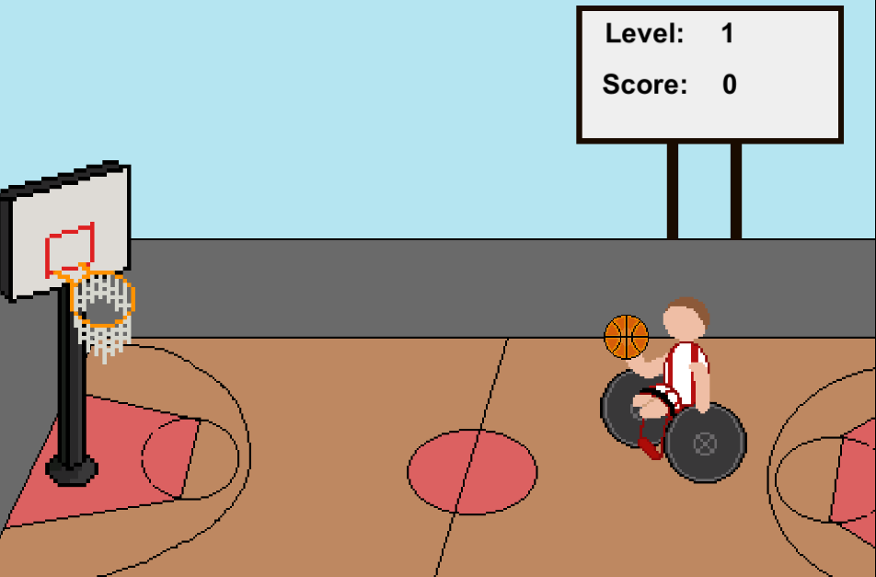
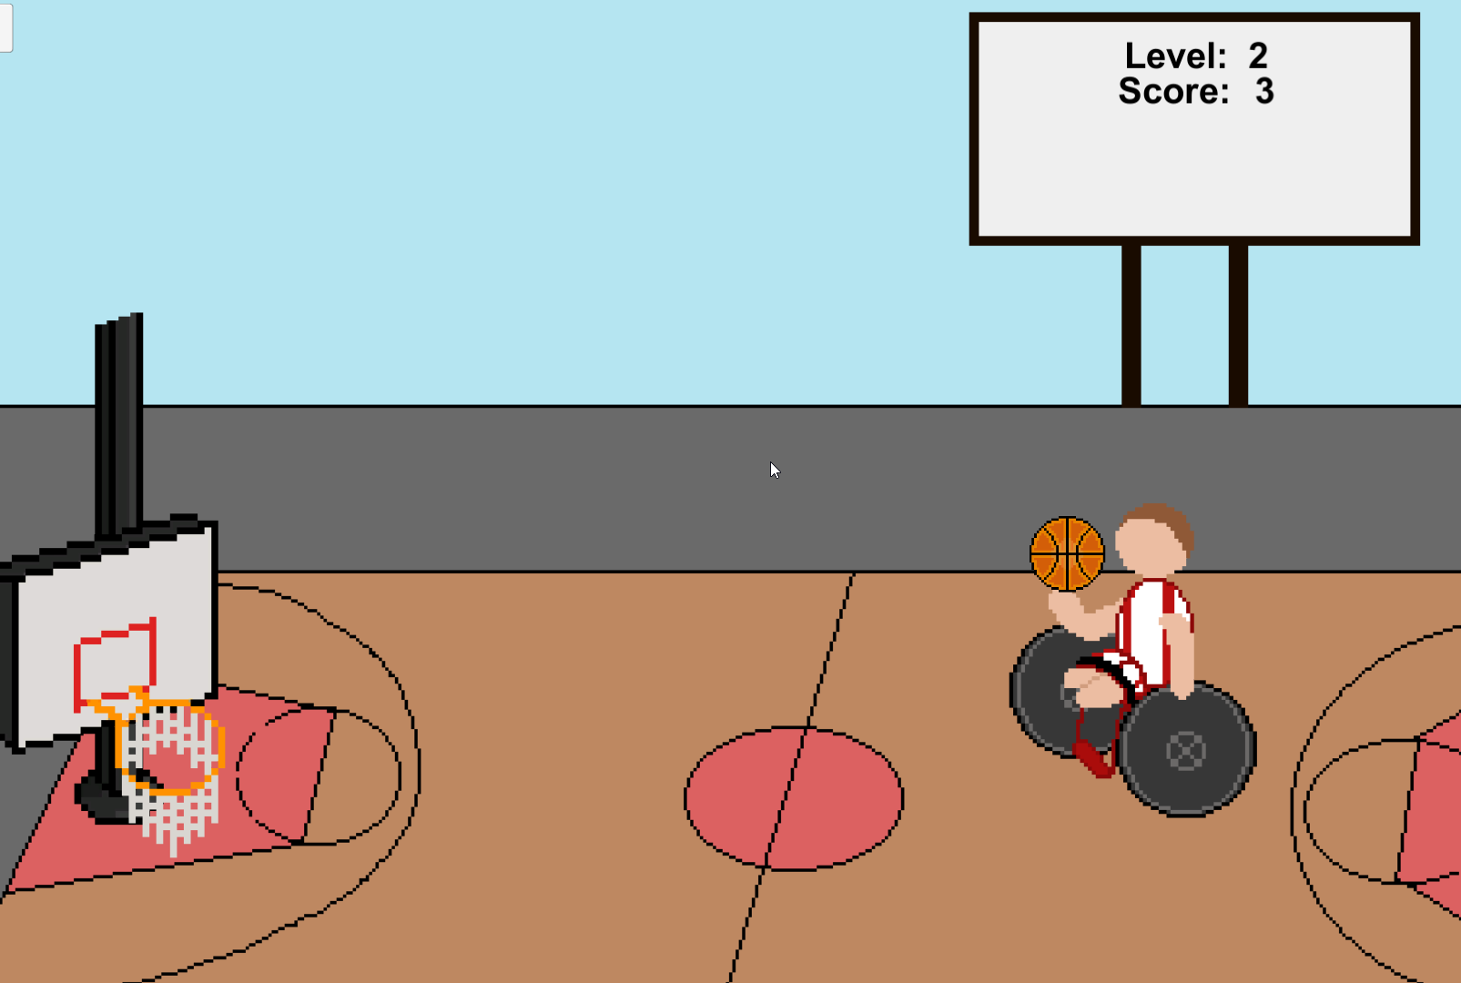
Prototype 1: Wheelchair Basketball Shoot
Notes:
This first prototype game is a simple 2D basketball shooter, where the player aims and releases a ball to a basketball net, gaining points for each shot. The player can be controlled by default with the A and D keys on a keyboard to move left and right on the screen, the ball following along with the player, the ball can then be aimed and released using the mouse and holding down the left mouse button and dragging on the screen to aim the ball into the basketball net. The strength at which the ball is fired depends on the speed and duration of the mouse button being held down. It is also possible to invert the y position of the ball drag with a mouse, instead of top to bottom you can change it to bottom to top in the game settings. I believe that the action needed to aim and shoot the ball using the mouse, by dragging on the screen and aiming at the basketball net is accessible because the player can start and end the drag position at any point on the screen in their preferred way, instead a specific control area. There are two levels in this prototype, the second more difficult than the first as the basketball net moves up and down whilst the player is trying to shoot, the first is a simple throw and shoot. Only two levels were made for this prototype because I felt that it would be enough to test the robustness of the game and it’s controls.
The idea for this prototype, as mentioned in the research, was through the AbleGamers charity’s article discussing the need for physical disabilities in the games we play, and a way this can be done is by creating a wheelchair basketball game, so this prototype ended up being the creating from the idea and inspiration.

Slide 12
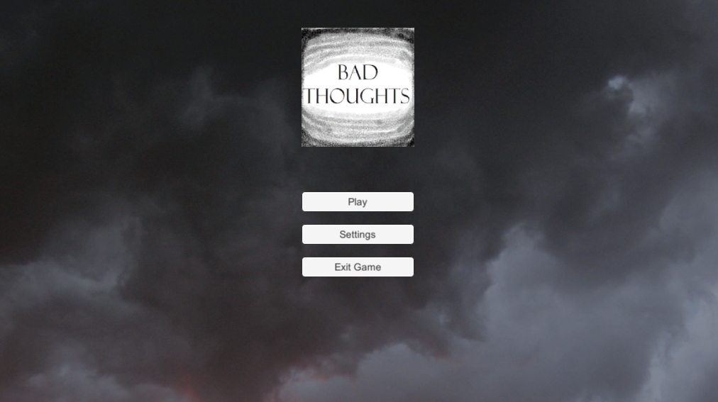

Prototype 2: Bye-Bye Thoughts
Notes:
This second prototype game is titled Bye-Bye thoughts and it is a simple 3D first person shooter which represents mental health. The player works their way round a 3D environment that is darkened and they must go around and shoot the ‘Bad Thoughts”, and each time one is shot away, the scene gets brighter until all the bad thoughts have been expelled and the scene is at it’s maximum brightness. The player gains points for each bad thought object that is shot, and there was going to be a timer so that if the player did not shoot the targets in time, the scene would fade to black and a game over scene would appear, however this was decided to be something that would be implemented in the full game rather than the prototype version because the timer and game over scene would only cause hinderance when testing. There is a follow camera used to create the perception of a first-person shooter, with the pistol in the front view, attached to the player and camera so that it moves with the two as the player navigates through the 3D world.
The player can be controlled by default with a keyboard and mouse, using WASD respectively for Forward, Left, Back and Right. Space bar for jumping, Left Shift when held down makes the player run, and the mouse left click button to shoot. These can all be changed in the game settings menu, just as the controls in the first prototype can be too. The shoot button can also be chosen, such as if the player would like to use a keyboard button to shoot, they could set any key or leave the default Left Control key just by pressing the button that does not say mouse, if they press the one labelled mouse, shooting will be controlled with the mouse left click.
In the game settings menu, there is also an option to use a controller, if selected the players controller will be able to be used to control and shoot, however it is not currently possible to rebind the controller buttons.

Slide 13
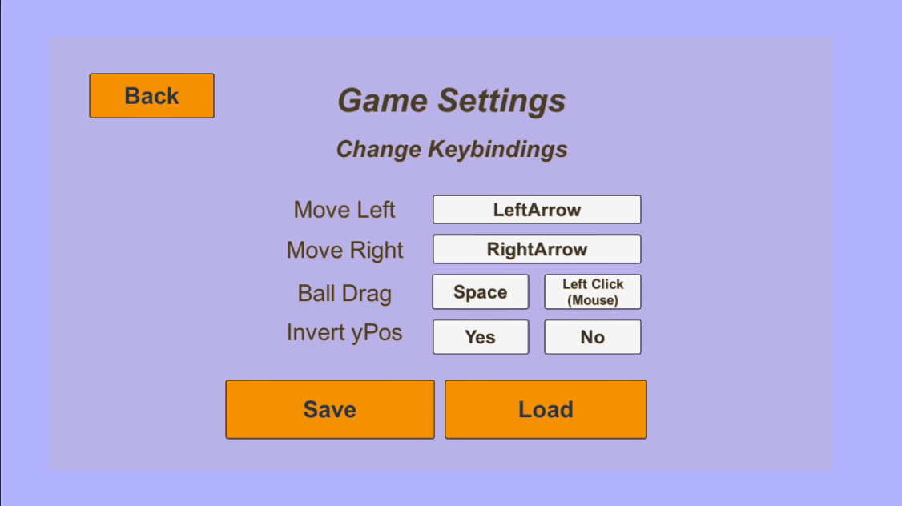
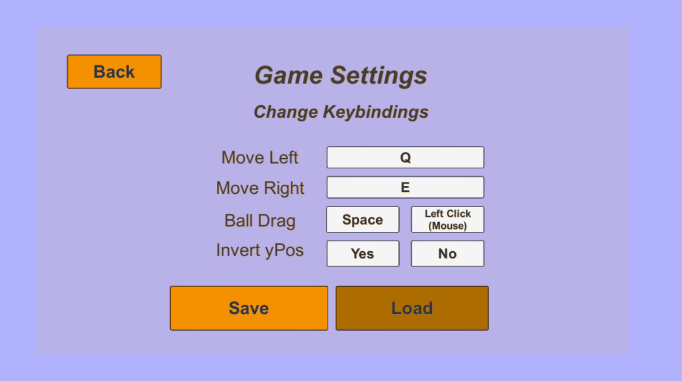
Control Mapping Program
Prototype 1 game settings
Notes:
The main part of this project, the control mapping program, is not actually a program itself, but instead exists within the game settings of each of the prototype games. It is designed to help with game accessibility, capturing the mapping of keyboard controls, how these mappings can move from two different playable prototype games and help benefit disabled players gaming experiences, making games more accessible and easier to play. With this the player can set their own key bindings for moving left and right, and when they press save it will save those keycodes to a json file that can be locally accessed, if the player is saving for the first time it creates a folder in their users documents file on their own computer, which can be easily accessed from both prototype games, as well as the player can easily find the json file on their system. And so, when they press load it will load any saved keycodes to the settings and those new keys can be used to control the player.

Slide 14
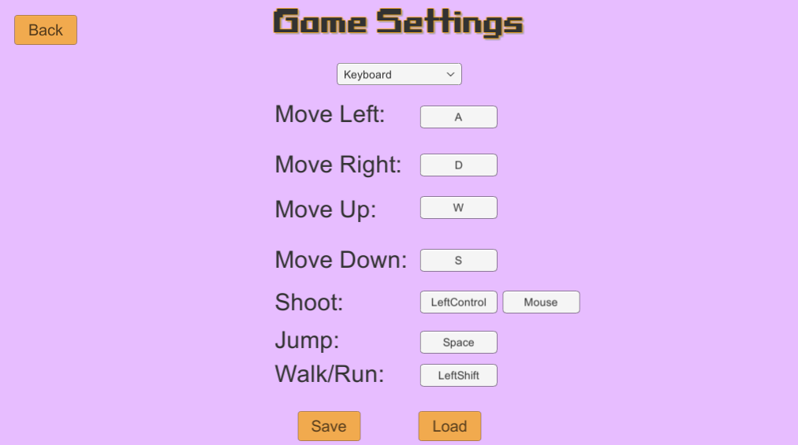
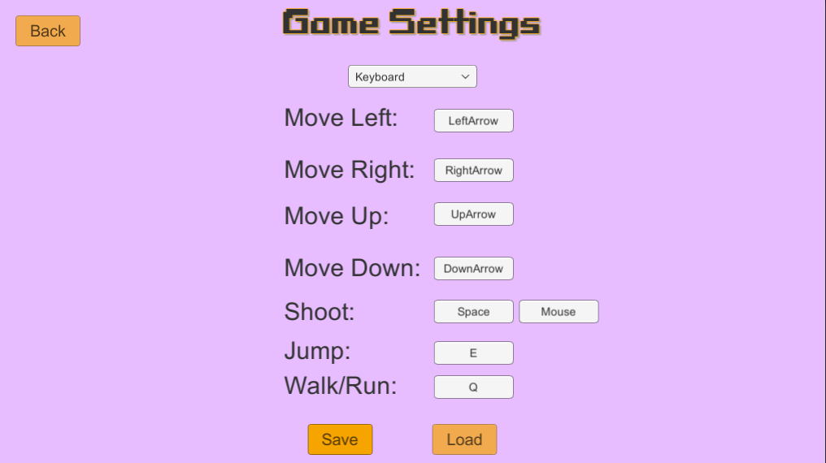
Control Mapping Program
Prototype 2 game settings
Notes:
This is the game settings meu for the second prototype, there are a lot more controls in this game, but the mapping program will still save any settings on here to the json file, and when going back to the other prototype it will just load any of the saved keycodes that match the ones in the other, therefore if you save all of these keys to be left, right, up and down arrows on this second prototype, if you moved back and loaded the json file to the first prototype, the left and right movement would be loaded to the left and right arrows only since there is no up and down in the first one.
The controls per prototype are relatively simple and easy to understand, which is important because if they’re too difficult to learn or if the game experience becomes uninteresting then you’re creating barriers that only skilled and patient players will be able to overcome.

Slide 15
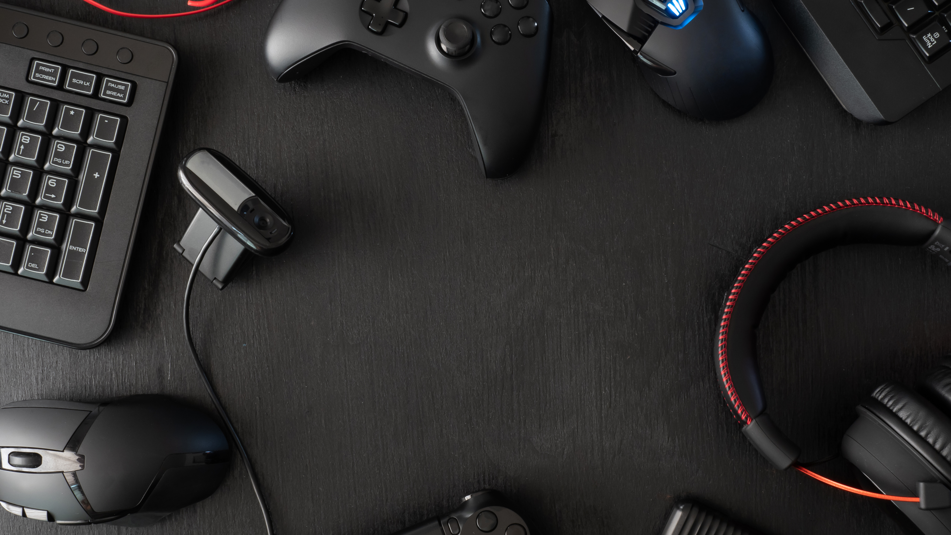
Project Development
Notes:
This topic is about the development of the project itself.

Slide 16
Timeline
Planning
Decide on what the project will be, choosing prototype games and mapping program
The prototype games, what they would be in terms of genre, gameplay and style
Creating the prototype games and the mapping program from the designs
Research
Testing
Any research for code that happened when implementing and creating the project.
Testing the project, it’s robustness and functionality as the development process happened. Testing each stage before moving on.
Designing
Implementation
Notes:
The methodology applied to this project was the Agile Methodology, this allowed the components of the project to be broken down into several stages, completing each stage before moving onto the next, making sure that all the requirements had been met and there were no bugs or issues in the functionality of that stage. These broken-down stages would become sprints, and there was already a clear split of the tasks needed, such as building each prototype first then moving on to the mapping program, and each of those major tasks had their own individual tasks.

Slide 17
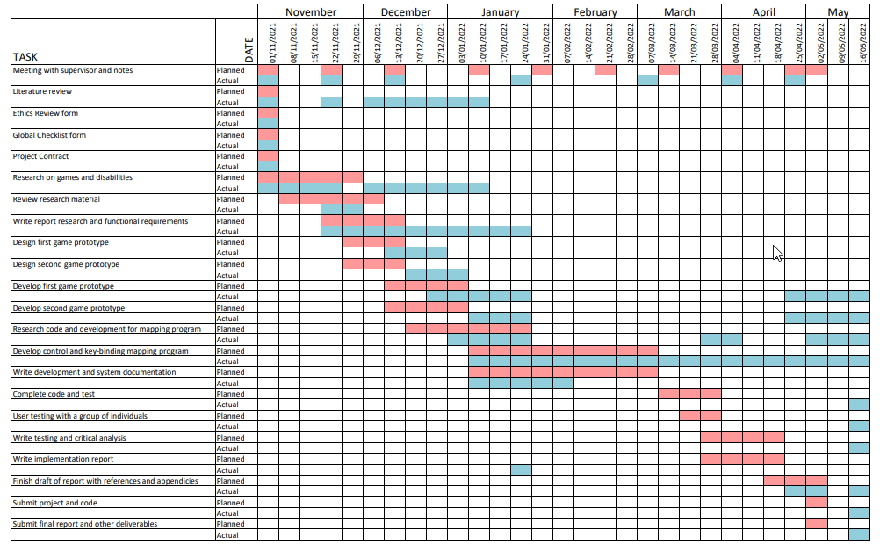
Gantt Chart
Notes:
This is a Gantt chart that was created at the start of the project, to split up the tasks and plan the development time for each one. The red squares are the planned dates and length of time for each section of the project, and the blue squares are the actual dates and time it took for each section of the project.

Slide 18
Developing the Mapping Program
Notes:
The ‘program’ itself is a collection of scripts made using C# language and Json. There is a save manager that includes the write and read functions to and from the json file, as well as creating the directory in which it is held and there is a save object script, which is slightly different between the two prototypes as it holds the key codes needed in each of its game settings scene. Those two scripts bring the essence of the control mapping program, but the game settings and game manager scripts were also essential in putting it together. Both prototypes have all 4 scripts so theoretically by taking these scripts and including them in another game, just by editing the game settings and game manager for that game, if a basis script was created it could be more executable as a program. However, that is not something that was created in this project, but it is something that would be developed in the future.

Slide 19
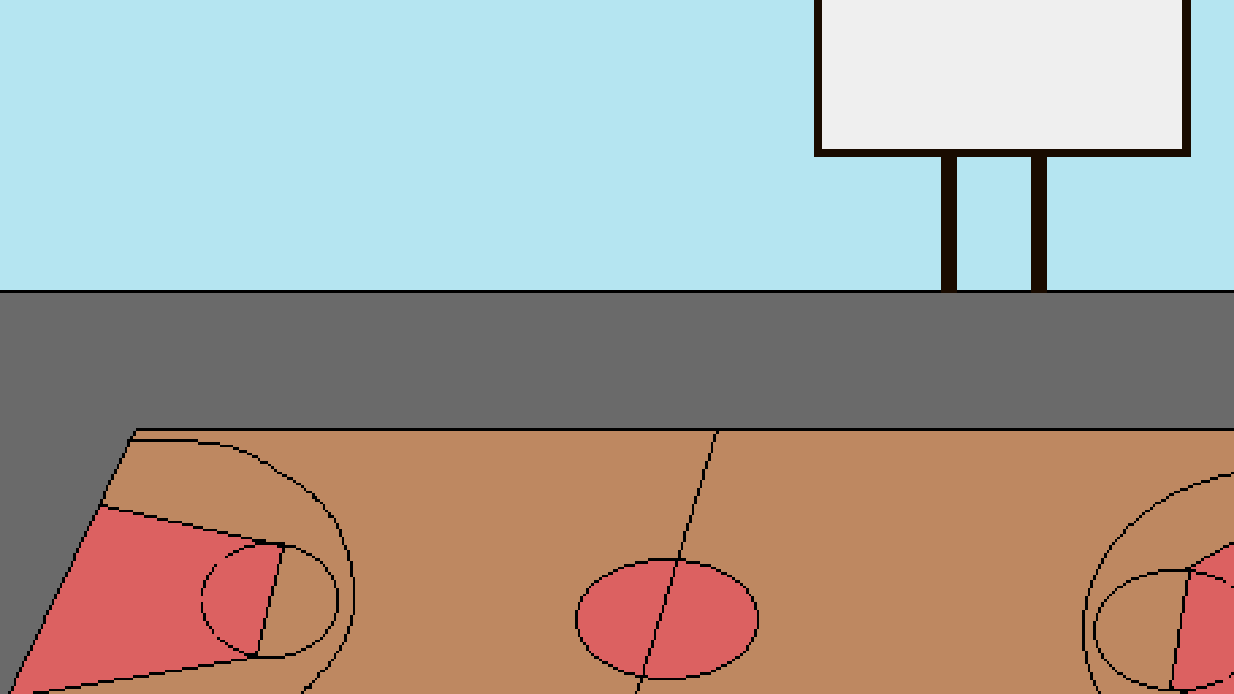
Demonstration

Slide 20
Summary
In Conclusion, I have been able to create a somewhat successful Control Mapping Program.
Things that could have been better include, time management, research in code and having controller button rebinding's.

Slide 21
References
Carrera, S. (2016). Accessibility in Games: Including People with Disabilities. Germany: LAP LAMBERT Academic Publishing.
Clarysse, P. (2021). The Genesis of Big Karma — Positive Disability Representation in Gaming. [online] Medium. Available at: https://pascalclarysse.medium.com/the-genesis-of-big-karma-positive-disability-representation-in-gaming-681692587af2 [Accessed 10 Jan. 2022].
Ready Players. (2016). Little Metal Limbs – Portrayals of the Disabled in Games. [online] Available at: https://readyplayers.wordpress.com/2016/06/23/little-metal-limbs-portrayals-of-the-disabled-in-games/ [Accessed 10 Jan. 2022].
TechTalk. (n.d.). MENTAL HEALTH & DISABILITIES. [online] Available at: https://techtalk.currys.co.uk/tv-gaming/gaming/diversity-in-gaming/games-and-disabilities.html#:~:text=Physical%20disabilities%20are%20portrayed%20in,re%20most%20likely%20to%20tackle [Accessed 10 Jan. 2022].
Valentine, R. (2020). Three-quarters of all US households include someone who plays video games. [online] gamesindustry.biz. Available at: https://www.gamesindustry.biz/articles/2020-07-15-three-quarters-of-all-us-households-include-someone-who-plays-video-games [Accessed 9 Dec. 2021].

Slide 22

Thank you, Any Questions?
Ruya Kumru-Holroyd
P2512547

